Slide 1
M4L 2013 Lesson 5
What is the meaning of meaning?
© Paul T. P. Wong, Ph.D., C.Psych
Notes:
Most people believe that meaningfulness is a good thing. A meaningful relationship is better than a meaningless one. Meaningful work is better than meaningless work. A meaningful life is better than a meaningless one. But what exactly is the meaning of meaning? Frankl tells us what meaning is and where to find it. I will further clarify Frankl’s concept by identifying the elements of meaning.

Slide 2
Overview
Frankl’s approach of finding meaning through values & transcendence
Freedom, responsibility, & self-transcendence as key concepts to logotherapy
Three types of enduring values
Wong’s four keys to unlocking the meaning of meaning
Notes:
At our last lesson, we already pointed out that logotherapy was launched as Frankl’s answer to the darkest chapter of modern history. Having survived the Holocaust, and having witnessed firsthand the unbelievable devastation and carnage of World War II, Frankl, like many of the intellectuals of his time, must have been wrestling with the question: What can we do to prevent another tidal wave of human evil? How can human beings survive evil and suffering?
To Frankl, living through the horrors of the Nazi concentration camp, survival had a special meaning. Survival meant more than just physical survival. To him, survival also meant the survival of human dignity and the human spirit, as well as the survival of the human species in the midst of inhumanity, atrocity, and the enormous power of mass destruction.
What is your answer to the persistent question of how to overcome human evil? Frankl’s genius is that he has offered us an uplifting and highly practical answer that works for his generation as well as for ours. No matter how difficult your current situation, no matter how hopeless and helpless you feel, you will find Frankl’s answer helpful.

Slide 3
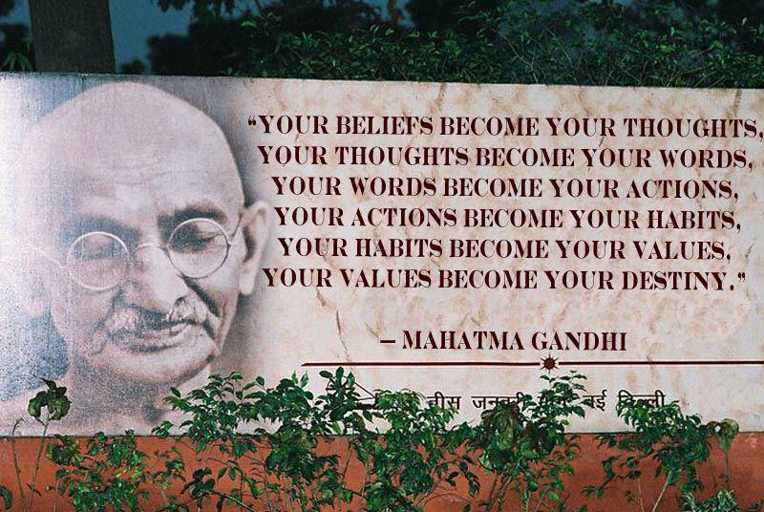
Every real change begins with belief.
Notes:
To recap what we taught in the last lesson, Frankl’s answer to evil and suffering is a spiritual one. Human salvation from evil is not based on science but rather happens by rediscovering the spiritual nature of human beings. Logotherapy is a spiritual therapy, because the healing of our brokenness and self-destructiveness comes from cultivating the meaning dimension, which resides in the innermost core of human nature.
Frankl understands the power of faith – the power of the unique human capacity of belief in God, in a transcendental reality, and in all the positive qualities of our spiritual nature. The basic tenets of logotherapy rest on beliefs.
Such positive beliefs in meaning are the fountainhead from which many blessings and adaptive benefits flow.
More specifically, Frankl’s overarching assumption is that life itself has intrinsic meaning and value and that every individual’s life has unique meaning and value. Then we have the three basic tenets:
Human beings have the will to meaning – the universal spiritual motivation to serve something bigger than ourselves, something that transcends self interest.
Meaning can be discovered in any circumstance.
Human beings have the freedom and courage to seek meaning.

Slide 4
Meaning is based on beliefs.
The overarching beliefs:
Life has intrinsic meaning & value
Every life has unique meaning & value
Every person has a unique calling to serve others (self-transcendence)

Slide 5
The Three Basic Tenets of Logotherapy
Freedom of will
Will to meaning
Meaning of life

Slide 6
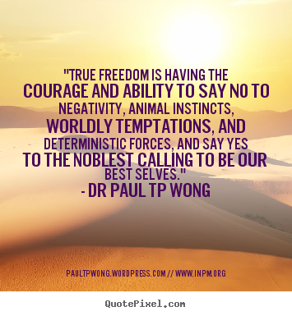
Notes:
Freedom of will, in the real sense, is a demonstration of spiritual power.

Slide 7
The 3 Values of Meaning
Attitudinal
Creative
Experiential
Notes:
In addition to beliefs, the second important principle is values. We find meaning not only through beliefs but also through values.
Frankl is emphatic that we do not create meaning arbitrarily. If we could, it might mean that Hitler, the mafia, and suicide bombers could all have lived meaningful lives.
Even though what is meaningful is an individual decision, it also needs an objective frame of reference. According to Frankl, meaning is the manifestation of a value through a responsible action. Whatever situation we are in, we are confronted with the question: How shall I respond? What is the right response? By following our conscience and by aligning ourselves with enduring values, we experience meaning.
There are three categories of enduring values which transcend time & culture:
(1) Creative value (creating something for the benefit & enjoyment of the whole society)
(2) Experiential value (enjoying nature, relationship, and the beauty all around us)
(3) Attitudinal value (when everything fails, we still have the freedom of attitude to take a stand -- to turn tragedy into triumph).
The attitudinal value actually refers to the values of courage and human dignity which refuse to surrender to fate, adversity, or oppression.

Slide 8
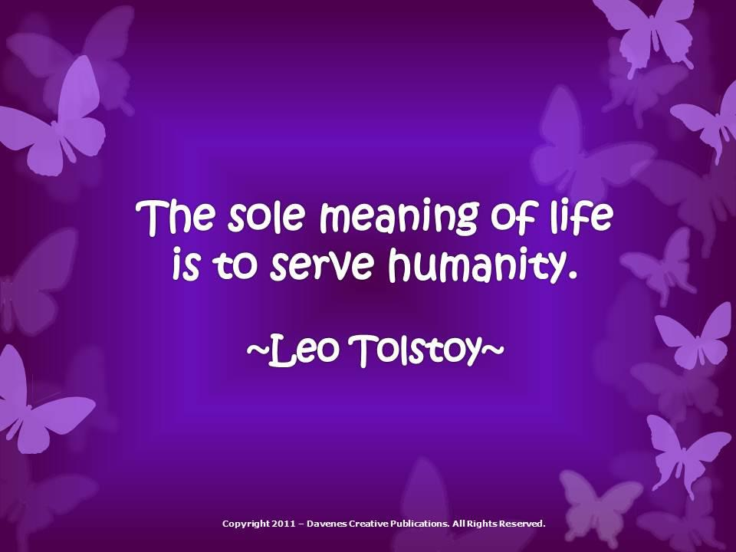
Creative Value
Notes:
Serving humanity and God is the essence of meaning in life.

Slide 9
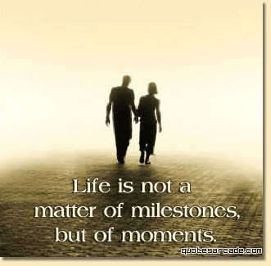
Experiential Value
Notes:
Capture and remember the meaningful moments – these are the building blocks of a meaningful life.

Slide 10
Attitudinal Value
A defiant attitude of freedom and responsibility against all oppressive forces endows us with human dignity.
All great achievements are made by people who dare to take a stand against all the odds and say, “Here I stand, so help me God.”

Slide 11
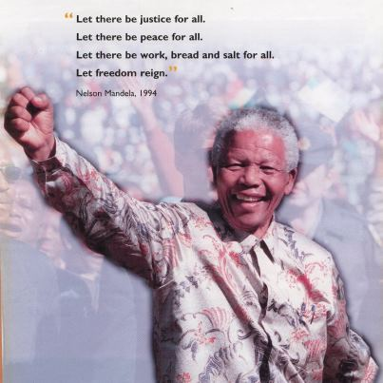

Slide 12
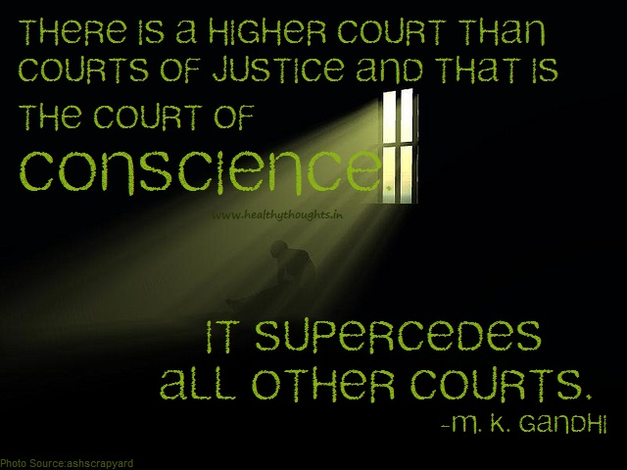
Notes:
Another area of emphasis for Frankl is conscience. How do we know that we are doing the right thing and making the right decision? Conscience is our guide.
During World War II, why did some people report to Nazi authorities on the Jews to get brownie points, while others risked their own lives to hide Jewish people?
The difference is conscience. Like meaning, conscience is part of the spiritual dimension of human nature. But for some people, their ambition, greed, and selfishness seared their conscience and buried it in the subconscious area.

Slide 13
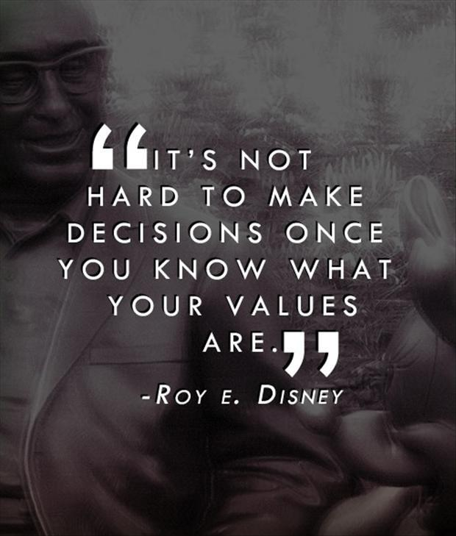

Slide 14
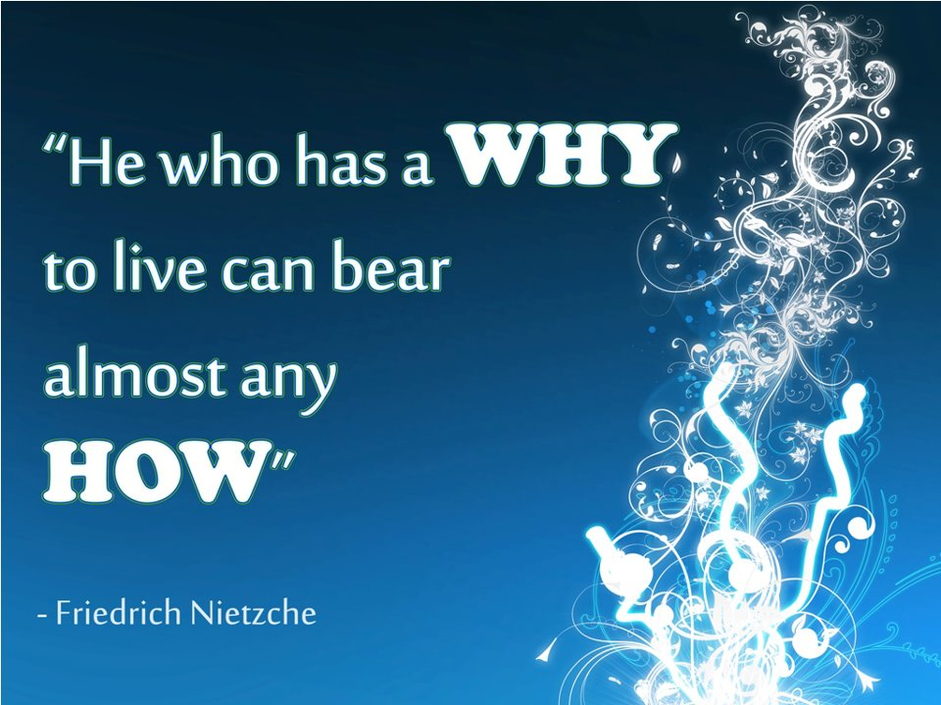
Meaning is the key to resilience.
Notes:
This is one of Frankl's most favourite quotations.
14

Slide 15
Frankl’s 7 Principles of Meaning
Meaning is spiritual
Meaning comes from faith & beliefs
Meaning is based on values
Meaning is responsible action
Meaning is guided by conscience
Meaning is an expression of courage
Meaning is the foundation for resilience and the good life

Slide 16
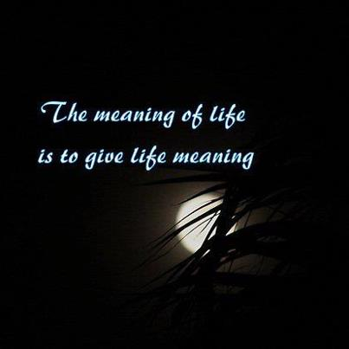
Meaning means PURE =
Purpose + Understanding + Responsibility + Enjoyment
Notes:
Finally, meaning shows us the pathways to living a rewarding, fulfilling life. More specifically, meaning is a four-fold blessing. It shows us four pathways to make life worth living.

Slide 17
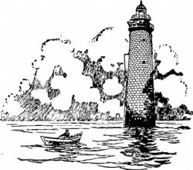
Purpose
Involves:
Life direction
Calling & mission
Objective & goals
Priorities
Core values
A sense of significance
Reasons for living

Slide 18
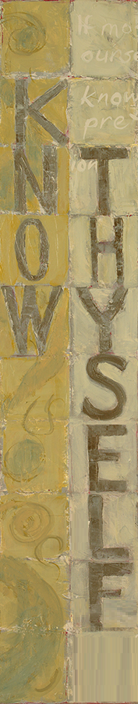
Understanding
Understand self & others
Understand the demand of the situation
Know right from wrong.
Understand one’s role in life
Achieve a sense of coherence
Can justify one’s own action

Slide 19

Responsibility
Freedom of choice
Self-determination
Internal control & self efficacy
Assume responsibility
of our own life & action
Civic duties
A moral agent

Slide 20
Enjoyment/Evaluation
The natural outcome of leading a purposeful and responsible life
A sense of well-being & serenity in all circumstances
Feel good for doing good
This stage involves reflection and sometimes re-evaluation of PURE.

Slide 21
Conclusion:
What is the meaning of meaning?
A primary human need for survival & flourishing
A unique human capacity for transforming negatives into positives
A double-cure: repairing and prevention
A fourfold-blessing (PURE): Purpose, Understanding, Responsibility & Enjoyment

Slide 22
The PURE way to a
Meaningful Relationship
Purpose
Shared beliefs, values, & life goals
Understanding
Mutual & deep understanding of each other
Responsibility
Each is responsible for caring for self & the other
Enjoyment
Enjoying time together
www.fb.com/MeaningfulLivingProject
paultpwong.wordpress.com

Slide 23
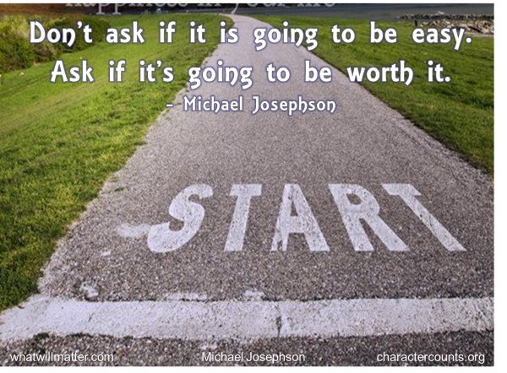
The Challenge of Meaningful Living
Notes:
To live a worthy life, you need to set a worthy life goal – a goal that is worth dying for.

