Slide 1
What is the meaning of meaning in life?
Embark on the quest for meaning.
© Paul T. P. Wong, Ph.D, C.Psych

Slide 2
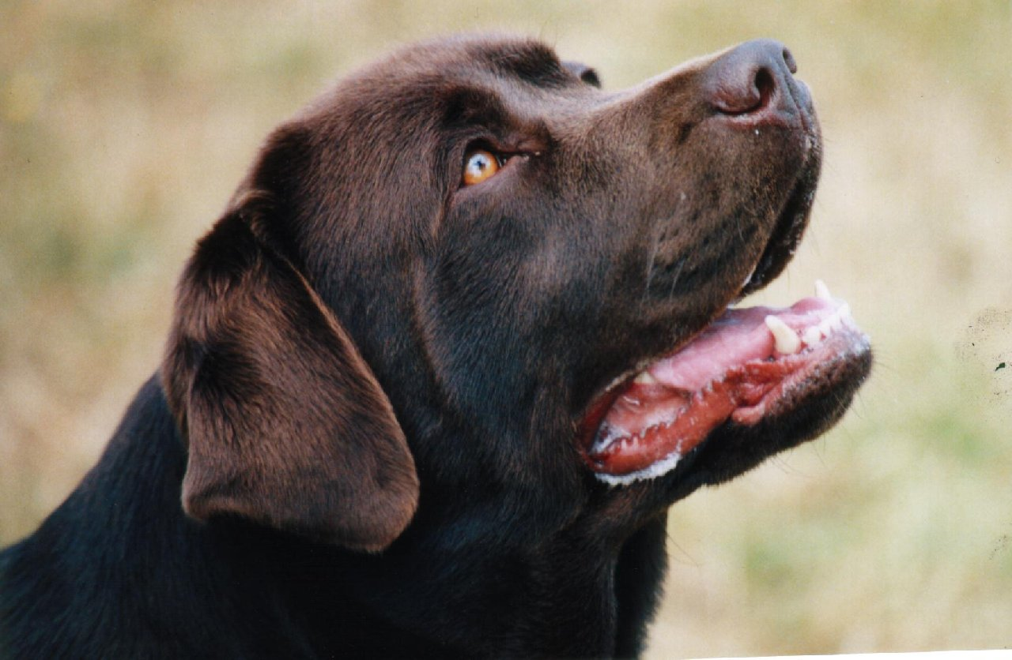
What does he want?
?

Slide 3
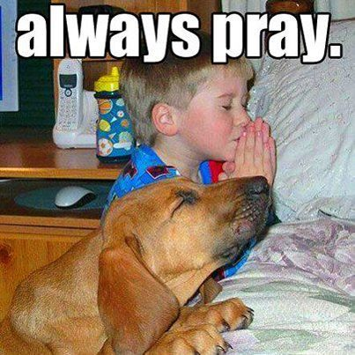
Notes:
Dogs do not pray or worship. They do not stare at the stars and experience a sense of awe; nor do they cry to God for help in times of trouble. Children have this capacity.

Slide 4
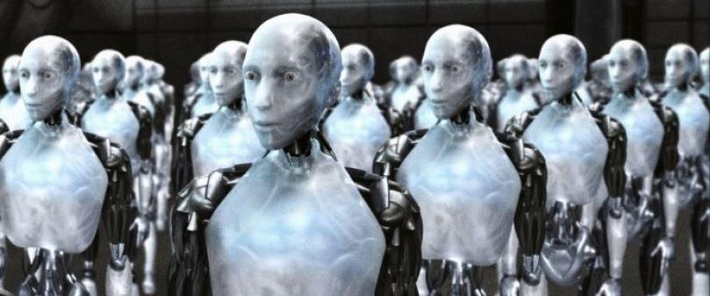
What is the difference between robots and human beings?
Notes:
What sets us apart from robots and other animals is our unlimited capacity for meaning-seeking, meaning-making and meaning-reconstruction.

Slide 5
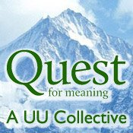
Meaning quest is a universal and uniquely human need & capacity
Notes:
The human quest for meaning is a universal story since antiquity.
The quest for meaning reflects the universal human need to be fully alive and fully human.
5

Slide 6
Notes:
The best evidence that we are hardwired for meaning is that children everywhere ask the same question: Why, why, why. They want to understand not only how nature works, but more importantly, how to make adults behave the way they do. They are not only naïve scientists; they are also naïve psychologists. Their curiosity enables them to grow and survive.

Slide 7
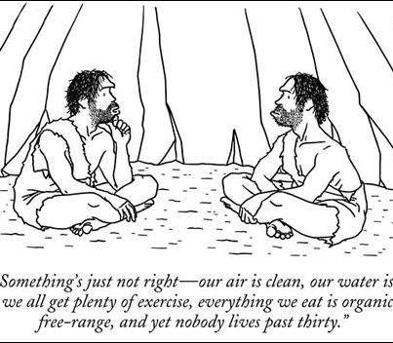
Even cavemen ask questions about nature and life
Notes:
The evidence of the human quest for meaning can also be found in the development of religions.

Slide 8
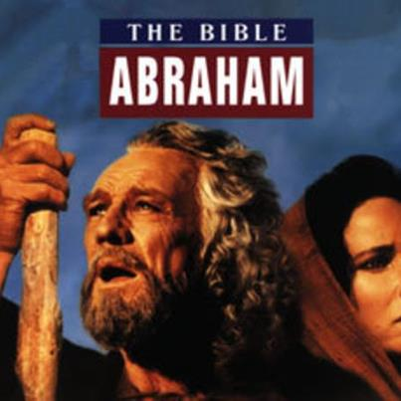
Abraham’s quest for meaning

Slide 9
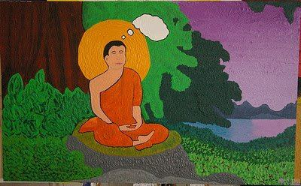
Gautama Buddha’s quest for meaning in India

Slide 10
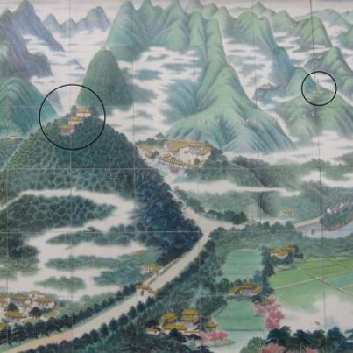
Lao Tsu’s quest for meaning in China

Slide 11
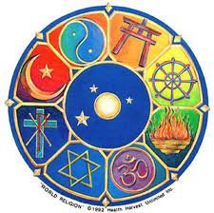
The quest for meaning is the mother of all religions.

Slide 12
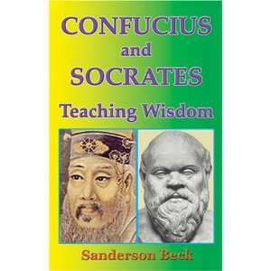
We need wisdom to guide our ways
Notes:
The quest for meaning is also found in philosophical writings in East and West. Like religion, philosophy is a source of wisdom helping us to understand who we are and how to live.
12

Slide 13
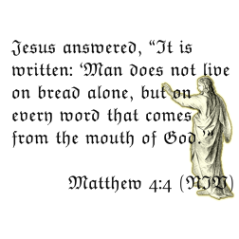
Human beings have more than physical needs
Notes:
This is a profound statement about the fact that human beings are different from all other animals, because they have a hunger for something spiritual. They have a hole in their soul, a vacuum in their heart which can only be filled by something spiritual and transcendental.

Slide 14
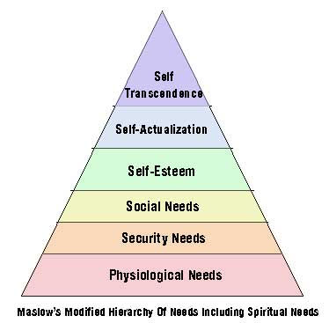
We have spiritual & existential needs
Notes:
Maslow has added self-transcendence as the highest level of human needs.

Slide 15
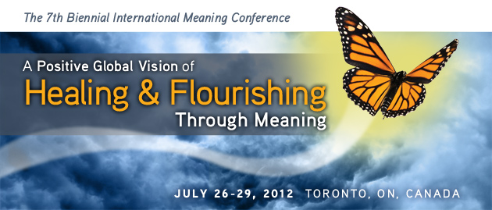
The capacity for meaning-seeking & meaning-making is a powerful tool for healing & flourishing
Notes:
The quest for meaning is not only a universal human need, but also a powerful capacity for survival and flourishing.

Slide 16
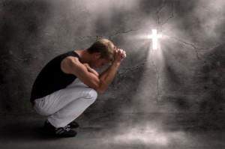
Meaning provides a double cure:
Repair what is broken and prevent what is harmful

Slide 17
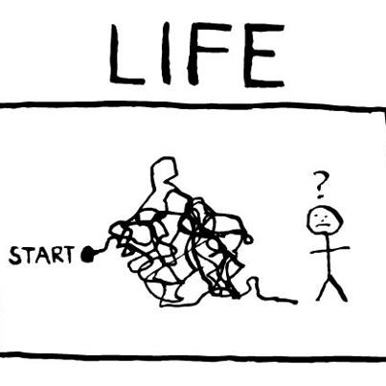
It takes meaning to navigate us through life
Notes:
Another important adaptive function of the meaning quest is that it helps us navigate through the minefield and mazes of life and enables us to arrive at our destination.

Slide 18
We need a sense of meaning and purpose to survive
Notes:
Most importantly, our capacity for meaning seeking and meaning making enables us to transform negatives into positives and gives us reasons for surviving adversities.

Slide 19
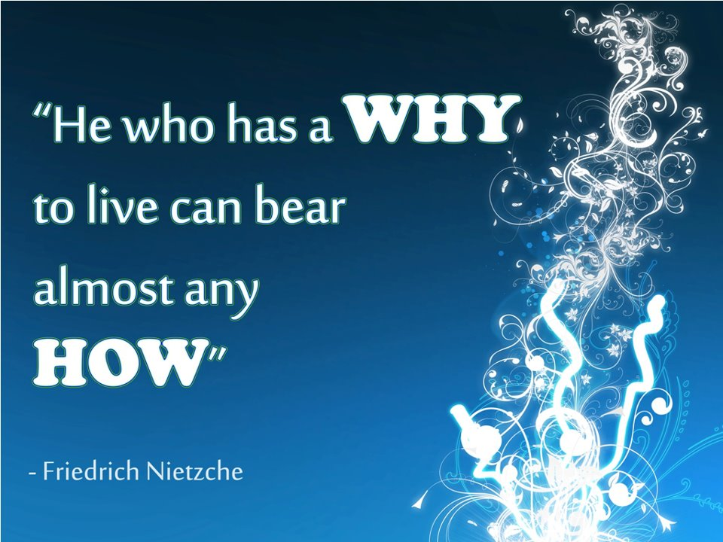
Meaning is the key to resilience
Notes:
This is one of Frankl's most favourite quotes.
19

Slide 20
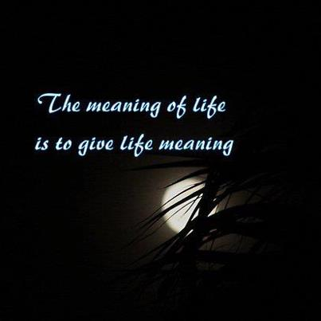
Meaning means PURE = Purpose + Understanding + Responsibility + Enjoyment
Notes:
Finally, meaning shows us the pathways to live a rewarding, fulfilling life. More specifically, meaning is a four-fold blessing. It shows us four pathways to make like worth living.

Slide 21
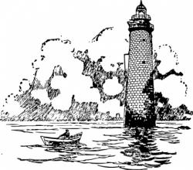
Purpose
Involves:
Life direction
Calling & mission
Objective & goals
Priorities
Core values
A sense of significance
Reasons for living

Slide 22
Understanding
Understand self and others
Understand the demand of the situation
Know right from wrong.
Understand one’s role in life
Achieve a sense of coherence
Can justify one’s own action

Slide 23
Responsibility
Freedom of choice
Self-determination
Internal control & self efficacy
Assume responsibility of our own life & action
Civic duties
A moral agent.

Slide 24
Enjoyment/Evaluation
The natural outcome of leading a purposeful and responsible life
A sense of well-being & serenity in all circumstances
Feel good for doing good
This stage involves reflection and sometimes re-evaluation of PURE.

Slide 25
Conclusion: What is the meaning of meaning?
A primary human need for survival & flourishing
A unique human capacity for transforming negatives into positives
A double-cure: repairing and prevention
A fourfold-blessing (PURE): Purpose, Understanding, Responsibility and Enjoyment

Slide 26
The meaning mindset vs. the success mindset
Meaning Fulfillment
Sacrificial Life
Ideal Life
Failure
Success
Wasted Life
Shallow Life
Emptiness
Notes:
If you choose the meaning-mindset, you can still find fulfillment, even when you fail to complete your mission (Examples: revolutionaries and heroes of faith in Hebrew chapter 11 of the Bible). Failure is no failure when one pursues a virtuous and noble mission for the common good.

Slide 27
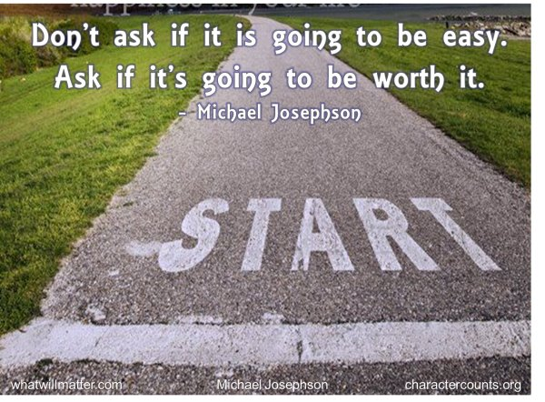
The challenge of meaningful living
Notes:
To live a worthy life, you need to set a worthy life goal – a goal that is worth dying for.

