Slide 1
Life Lesson 8: How do I overcome adversity?
Equip yourself with the right attitude
& outlook on life.
© Paul T. P. Wong

Slide 2
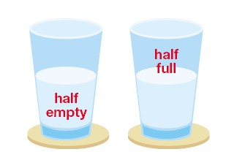
Is the glass half empty or half full?
Notes:
Which answer is more consistent with reality and resonant with your personal experiences? If water is a metaphor of resources or life, then everything is being spent – everything goes down, without the promise of resupply or new resources.

Slide 3
Develop the right attitude & outlook on life
Notes:
“Your living is determined not so much by what life brings to you as by the attitude you bring to life; not so much by what happens to you as by the way your mind looks at what happens.” Khalil Gibran

Slide 5
What Is Your Outlook on Life?
Optimism: Life is good, only expect good things to happen
Pessimism: Life is bad, only expect bad things to happen
Optimistic Pessimism: Life is both good and bad, but eventually good will prevail
Notes:
Your attitude towards life may have important implications of for your life. Which attitude is most adaptive?

Slide 6
Lesson 1: Have A Tragic Sense of Life
“In this world you will have trouble.” - Jesus
The first noble truth of Buddhism: Life is full of suffering
Every life is touched by tragedy
Having a tragic sense of life offers you the best preparation for the tragedies of life
Notes:
We can prove that is full of suffering deductively, inductively and experientially. Having a tragic sense of life is like stress inoculation which immunizes you against adversities. This is your first line of defense.

Slide 7
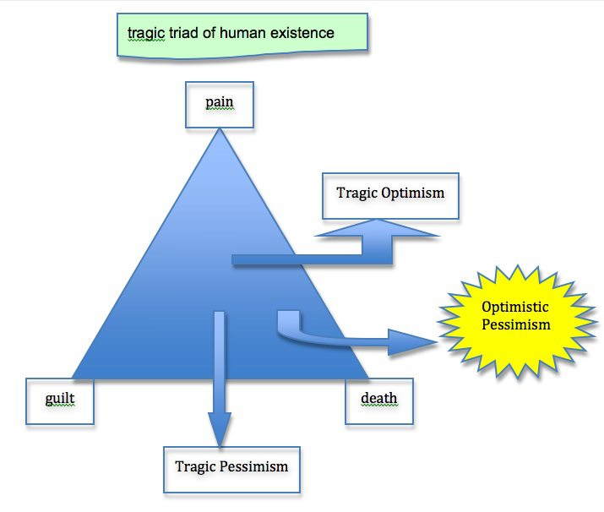
Viktor Frankl’s tragic optimism
Notes:
Viktor Frankl’s tragic triad is based on his personal experiences and his observation of life. His construct of tragic optimism is based on the human capacity for meaning making which transform suffering to human achievement, death to personal responsibility, and guilt to personal growth. This is the basis for Positive Psychology 2.0 (Wong, 2011).

Slide 8
Components of tragic optimism (TO)
Acceptance of the bleak reality
Affirmation of the value and meaning of life
Self-transcendence (altruism)
Faith in God and others
Courage to face adversity
Notes:
This is the only kind of optimism that can survive whatever life throws at you. Traditional thinking of optimism is based on positive expectations and self-confidence. TO is based on optimistic pessimism.

Slide 9
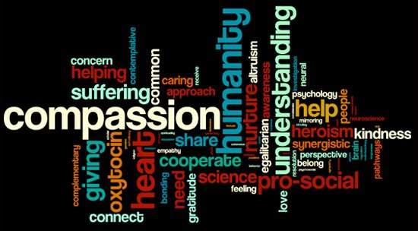
Self-transcendence enhances the well-being & meaning in life of both self and others in both good and bad times.

Slide 10
“COURAGE IS THE FIRST OF THE VIRTUES, BECAUSE IT MAKES ALL OTHERS POSSIBLE.” ~Aristotle

Slide 11
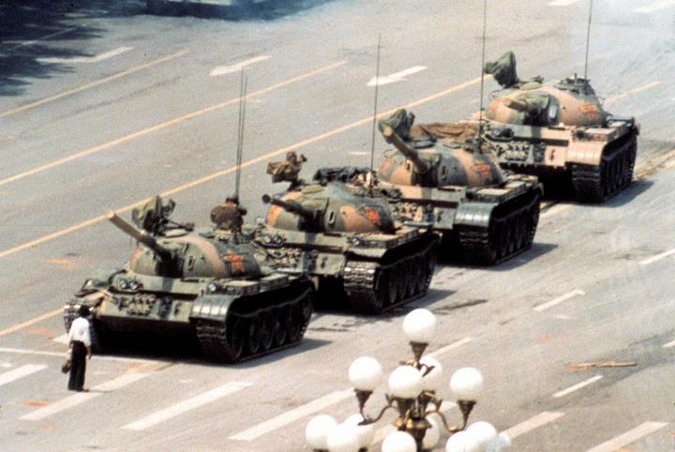
Courage means having the capacity to stand up for what you believe and face fears and dangers unflinchingly.

Slide 12
It takes courage to confront and accept yourself in spire of all your limitations.

Slide 13
Courage empowers you to expand your hope beyond the walls that confine you.

Slide 14
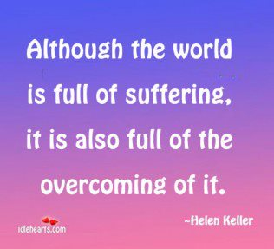
A good example of tragic optimism
Notes:
A triumphant tragic sense of life is necessary for your to face adversities and recover from traumas. Most therapeutic approaches to treat PTSD is to empower the clients to integrate past traumas with a positive future.

Slide 15
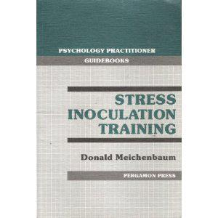
A tragic sense of life is an effective inoculation against tragedies

Slide 16
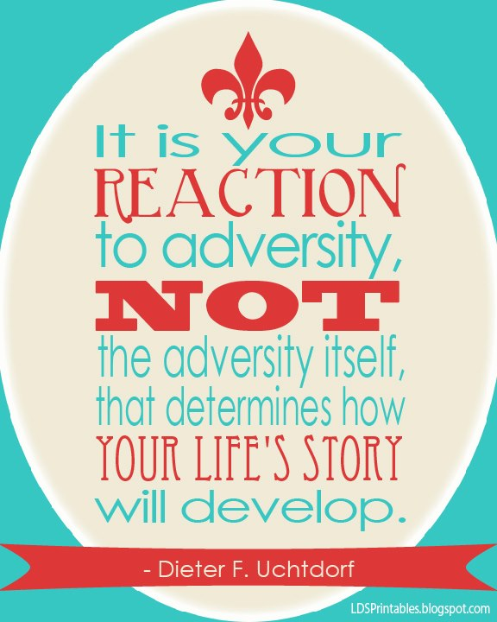
Lesson 2: What matters most is how you react to adversity
Notes:
Two people may have experienced an identical trauma with very different outcomes. One becomes a better and stronger person, and another becomes a clinical case of depression and PTSD.

Slide 17
3 Common Responses to Adversity
Catastrophizing: Creating unnecessary anxieties & suffering
Trivializing: Ignoring the real danger & believing in delusions
Assessing it rationally: Appraising the situation realistically but with a sense of TO

Slide 18
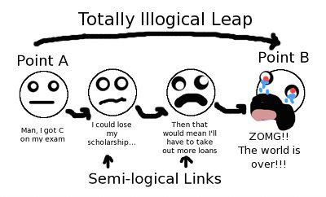
The process of catastrophizing: Negative schema & anticipation

Slide 19
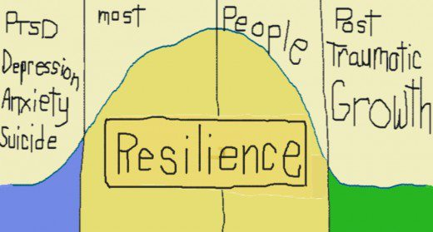

Slide 20
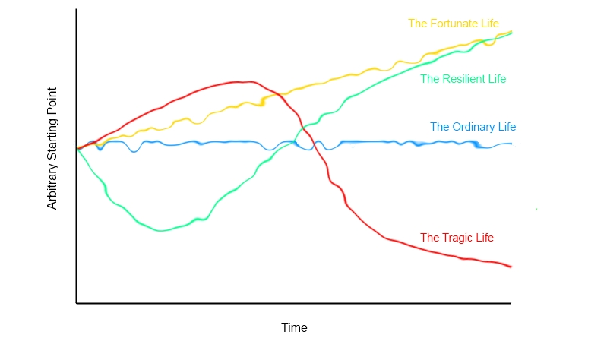
4 Prototypical Life Trajectories

Slide 21
Lesson 3: Face adversity with a meaning mindset
Focus on situational meaning rather than global meaning
Seeking both causal and existential understanding
Develop a meaning mindset as a frame of reference for both positive and negative events
Learn how to make full use of our capacity for meaning-seeking and meaning-making

Slide 22
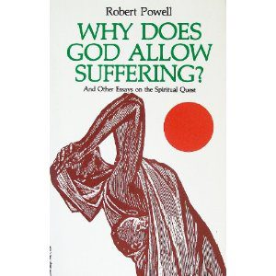
Suffering triggers the quest for meaning
Notes:
Suffering is probably for the trigger to the human quest for meaning and spirituality. I can imagine a cave woman crying out “Why” when her baby was devoured by a wild animal. The “Why” question is probably the most important question every asked by humanity. I have found that people are most likely to ask Why questions in situations of uncertain and negative situations (Wong & Weiner, 1981). I have found that people are engaged in both casual attribution and existential attribution. Causal attribution is the basis for science. Existential attribution is the basis for philosophy, religion and psychology.

Slide 23
“Why” is a universal cry for help

Slide 24
Meaning seeking may be unpleasant
It can pose a challenge to your beliefs
It can lead to rumination and depression
There are no answers to the problem of suffering
There are no answers to the problem of injustice
Viktor Frankl emphasizes that it is more adaptive to move from “Why” to “How” or “What”

Slide 25
Meaning-making is an all-purpose tool for effective coping
Our universal capacity for meaning-making is able to protect us against hardships and traumas, but also able to guides us towards achieving a preferred future
Meaning-making empowers us to endure, transcend and transform all trials and tribulations
Meaning-making is involved us both the PURE strategy of flourishing and the ABCDE strategy of overcoming

Slide 26
Conclusions
In this lecture, we have learned three important life attitudes which can overcome adversity:
Develop a tragic sense of life as an inoculation against adversity
You have the freedom to react to adversity rationally
Cope with every tragic event through the meaning mindset and meaning-making capacity

